Slide 1
Breast Neoplasm - NCIT:C291
BIO392 Project Presentation
Andrej Sievi
Eric Thiele
2023-10-05

Slide 2
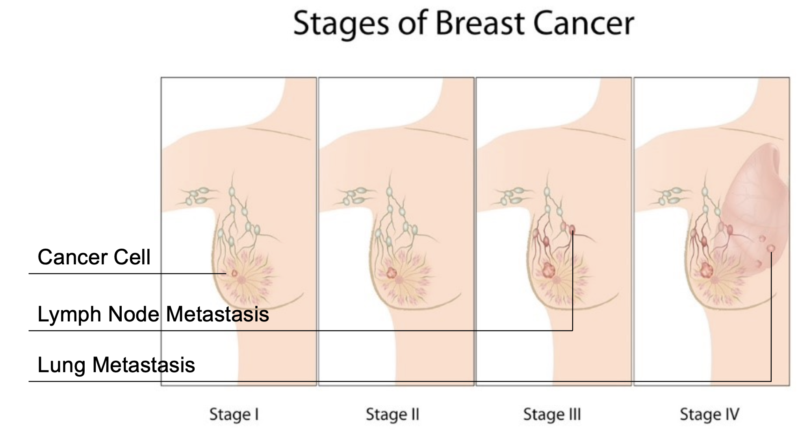
Introduction
2023-10-05
Andrej Sievi, Eric Thiele

Slide 3
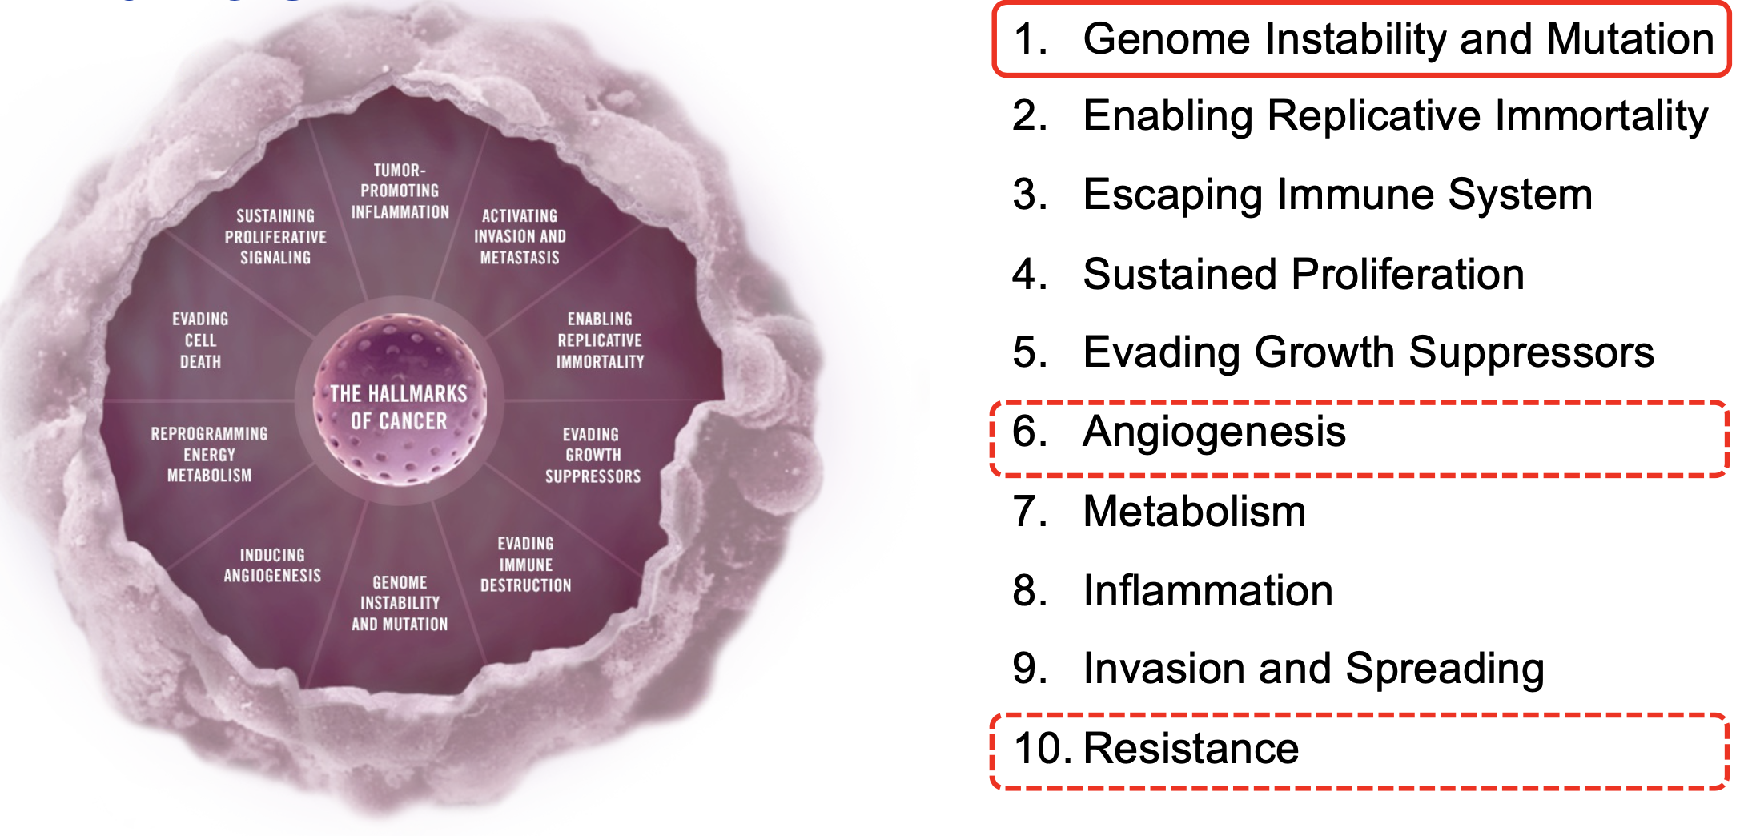
Introduction
2023-10-05
Andrej Sievi, Eric Thiele

Slide 4
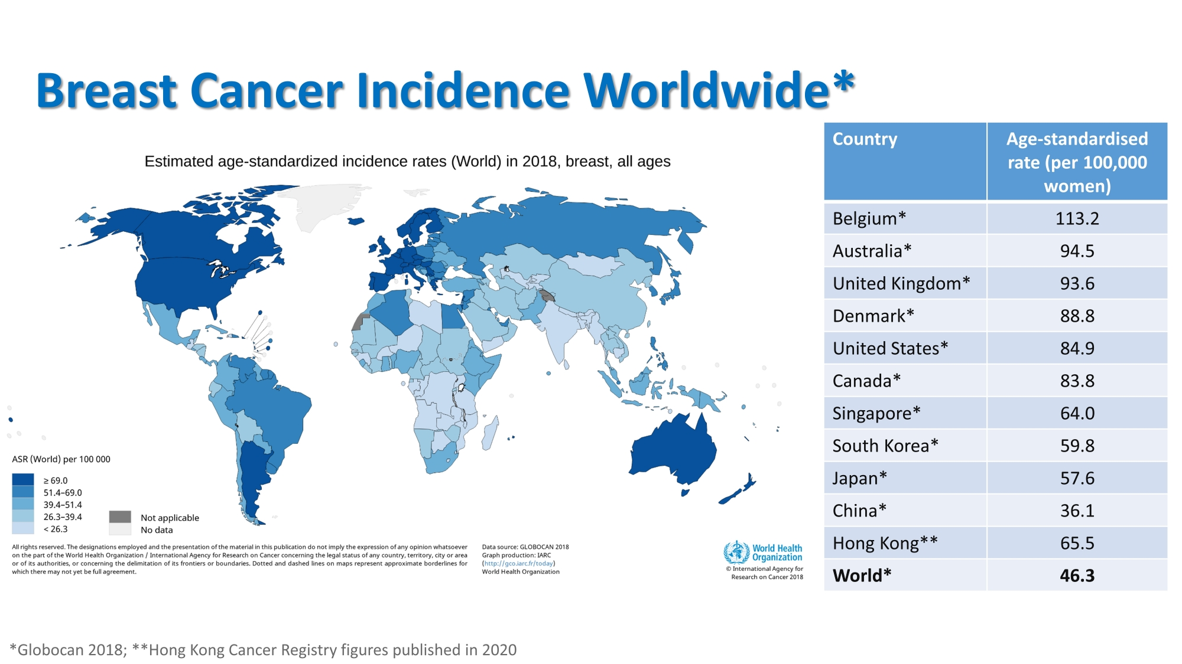
Introduction
2023-10-05
Andrej Sievi, Eric Thiele

Slide 5
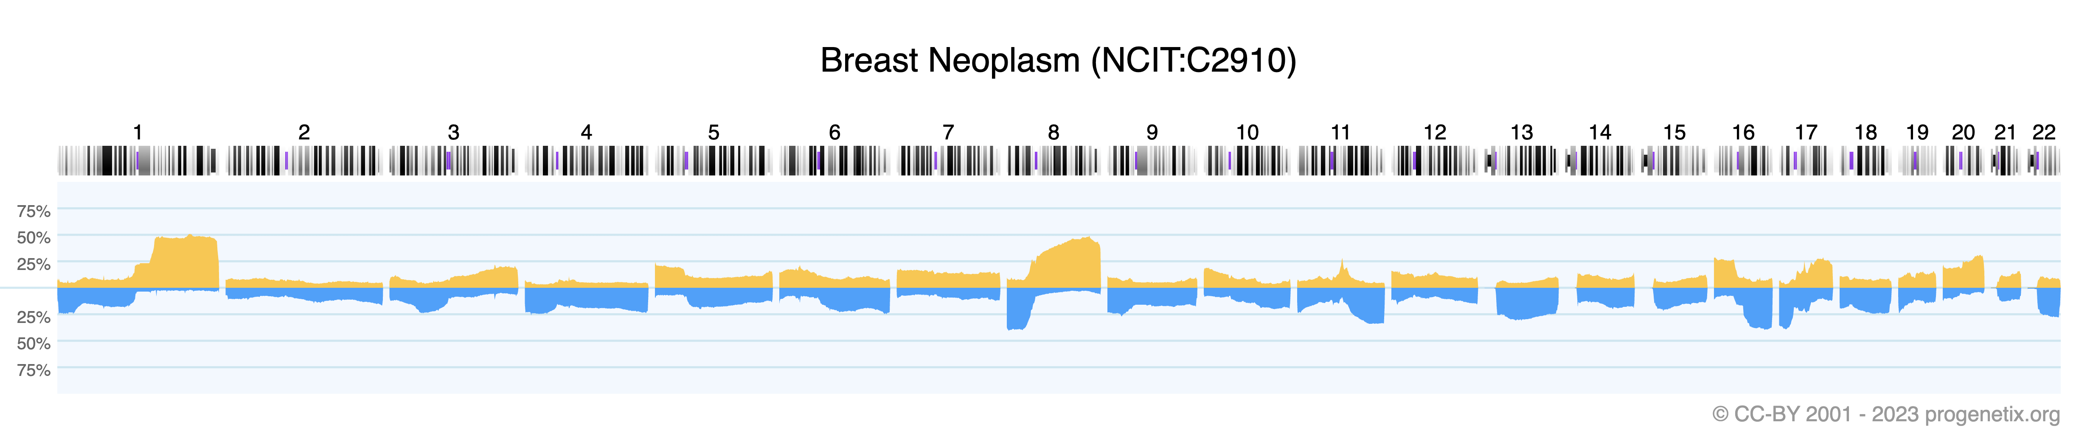
Introduction
2023-10-05
Andrej Sievi, Eric Thiele

Slide 6
Aims
2023-10-05
Andrej Sievi, Eric Thiele

Slide 7
Results
2023-10-05
Andrej Sievi, Eric Thiele

Slide 8
Conclusions
2023-10-05
Andrej Sievi, Eric Thiele

Slide 9
Discussion
2023-10-05
Andrej Sievi, Eric Thiele

